Slide 1
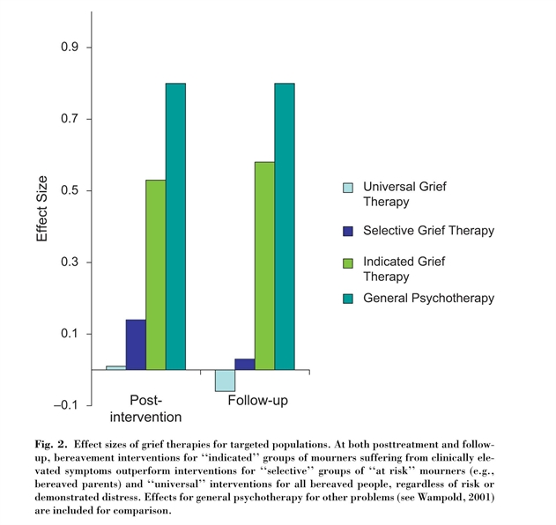
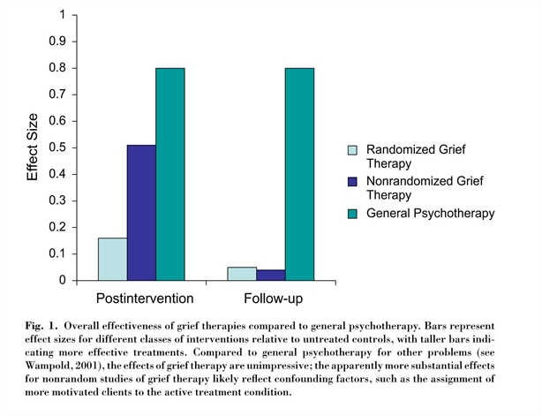
Meta-analysis of grief therapy (Neimeyer & Currier, 2009)

